Slide 1
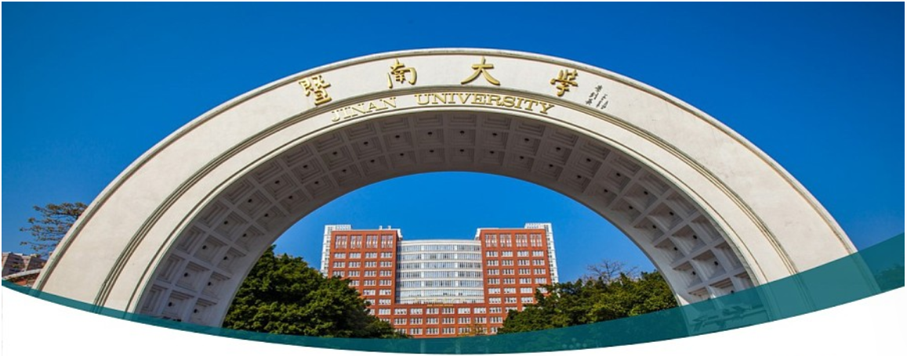

Machine Learning 11. Decision Tree
Xueyuan Gong
School of Intelligent Systems Science and Engineering

Slide 2
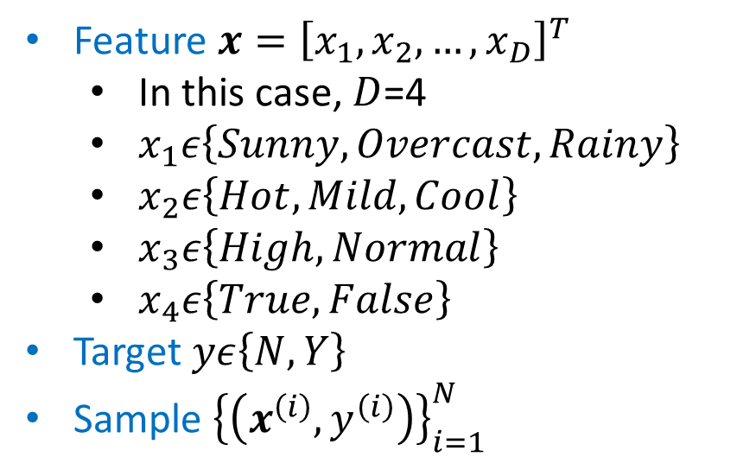
Classification
Dataset
Index | Weather | Temperature | Humidity | Windy | Play Tennis
1 | Sunny | Hot | High | False | N
2 | Sunny | Hot | High | True | N
3 | Rainy | Cool | Normal | True | N
4 | Sunny | Mild | High | False | N
5 | Rainy | Mild | High | True | N
6 | Overcast | Hot | High | False | Y
7 | Rainy | Mild | High | False | Y
8 | Rainy | Cool | Normal | False | Y
9 | Overcast | Cool | Normal | True | Y
10 | Sunny | Cool | Normal | False | Y
11 | Rainy | Mild | Normal | False | Y
12 | Sunny | Mild | Normal | True | Y
13 | Overcast | Mild | High | True | Y
14 | Overcast | Hot | Normal | False | Y
Feature $x={\left[x_{1},x_{2},…,x_{D}\right]}^{T}$
In this case, $D$=4
$x_{1}ε\left\{Sunny, Overcast, Rainy\right\}$
$x_{2}ε\left\{Hot, Mild, Cool\right\}$
$x_{3}ε\left\{High,Normal\right\}$
$x_{4}ε\left\{True,False\right\}$
Target $yε\left\{N,Y\right\}$
Sample ${\left\{\left(x^{\left(i\right)},y^{\left(i\right)}\right)\right\}}_{i=1}^{N}$

Slide 3
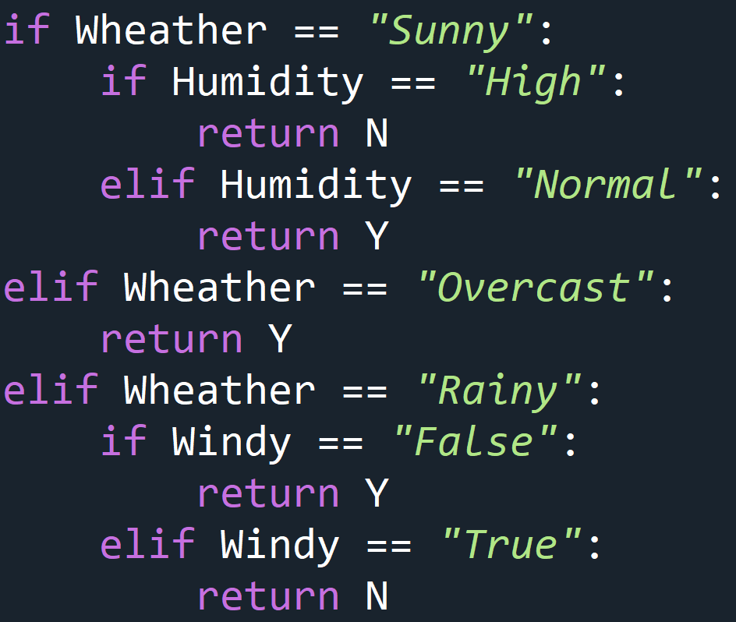
Decision Tree
Model
Weather
Sunny
Rainy
Overcast
Humidity
Y
Windy
High
Normal
True
False
N
Y
N
Y

Slide 4
Decision Tree
1 | N
2 | N
4 | N
N
1 | N
2 | N
4 | N
10 | Y
12 | Y
High
1 | N
2 | N
3 | N
4 | N
5 | N
6 | Y
7 | Y
8 | Y
9 | Y
10 | Y
11 | Y
12 | Y
13 | Y
14 | Y
Humidity
Sunny
Normal
10 | Y
12 | Y
Y
6 | Y
9 | Y
13 | Y
14 | Y
Weather
Overcast
Y
3 | N
5 | N
N
Rainy
3 | N
5 | N
7 | Y
8 | Y
11 | Y
True
Windy
False
7 | Y
8 | Y
11 | Y
Y

Slide 5
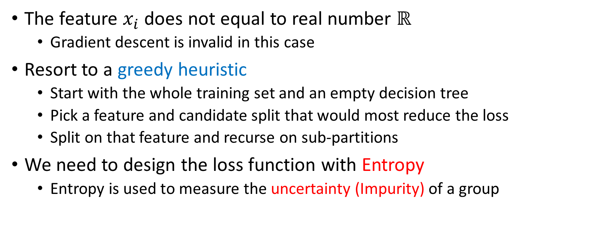
Decision Tree
The feature $x_{i}$ does not equal to real number $ℝ$
Gradient descent is invalid in this case
Resort to a greedy heuristic
Start with the whole training set and an empty decision tree
Pick a feature and candidate split that would most reduce the loss
Split on that feature and recurse on sub-partitions
We need to design the loss function with Entropy
Entropy is used to measure the uncertainty (Impurity) of a group

Slide 6


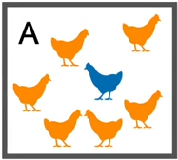
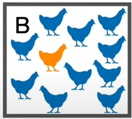
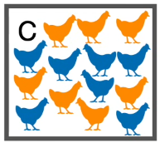
Surprise
Imagine we had two types of chickens, orange and blue
Surprise is low if we picked up an orange chicken in A
Surprise is high if we picked up an orange chicken in A
Surprise is higher if we picked up an orange chicken in B
Surprise is lower if we picked up an orange chicken in B
It is equally surprised regardless of what color chicken we picked up
Surprise is, in some way, inversely related to probability

Slide 7
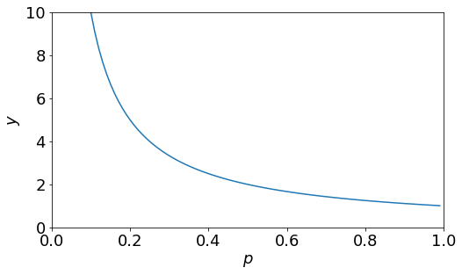


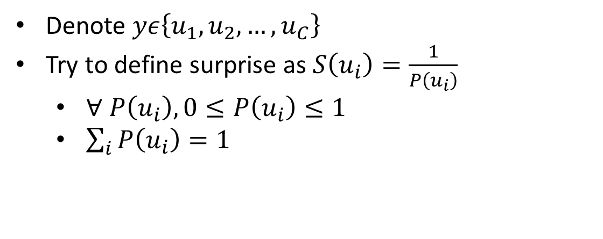
Define Surprise
Denote $yε\left\{u_{1},u_{2},…,u_{C}\right\}$
Try to define surprise as $S\left(u_{i}\right)=\frac{1}{P\left(u_{i}\right)}$
$∀ P\left(u_{i}\right), 0≤P\left(u_{i}\right)≤1$
$\sum_{i}{P\left(u_{i}\right)=1}$
Imagine there is a terrible coin and every time we flipped it we got heads
The surprise should be zero if the next flip gave us head

Slide 8
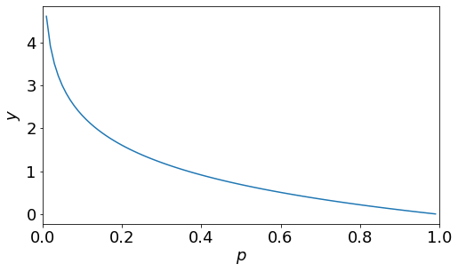
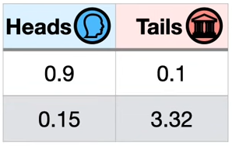
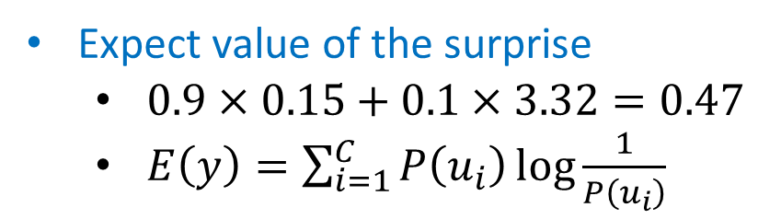
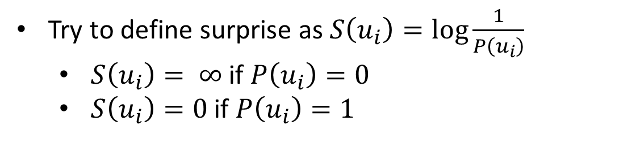


Define Surprise
Commonly, it is the log to base 2
Try to define surprise as $S\left(u_{i}\right)=\log{\frac{1}{P\left(u_{i}\right)}}$
$S\left(u_{i}\right)= ∞$ if $P\left(u_{i}\right)=0$
$S\left(u_{i}\right)=0$ if $P\left(u_{i}\right)=1$
$$P\left(u_{i}\right)$$
$$S\left(u_{i}\right)$$
Expect value of the surprise
$0.9×0.15+0.1×3.32=0.47$
$E\left(y\right)=\sum_{i=1}^{C}{P\left(u_{i}\right)\log{\frac{1}{P\left(u_{i}\right)}}}$
This is Entropy

Slide 9
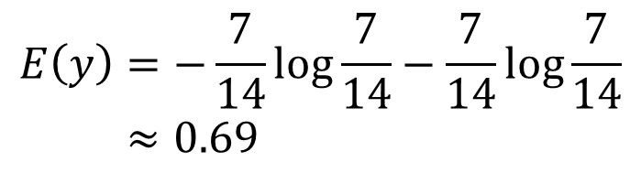
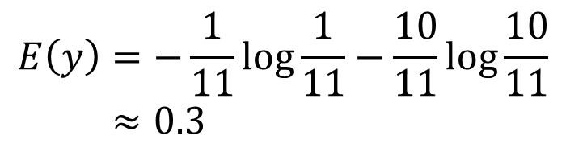
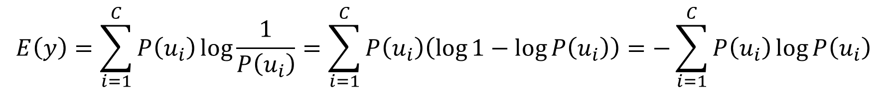
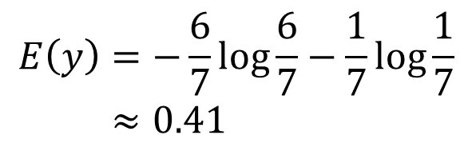
Entropy
$$E\left(y\right)=\sum_{i=1}^{C}{P\left(u_{i}\right)\log{\frac{1}{P\left(u_{i}\right)}}}=\sum_{i=1}^{C}{P\left(u_{i}\right)\left(\log{1}−\log{P\left(u_{i}\right)}\right)}=−\sum_{i=1}^{C}{P\left(u_{i}\right)\log{P\left(u_{i}\right)}}$$
$$E\left(y\right)=−\frac{6}{7}\log{\frac{6}{7}−\frac{1}{7}\log{\frac{1}{7}}}≈0.41$$
$$E\left(y\right)=−\frac{1}{11}\log{\frac{1}{11}−\frac{10}{11}\log{\frac{10}{11}}}≈0.3$$
$$E\left(y\right)=−\frac{7}{14}\log{\frac{7}{14}−\frac{7}{14}\log{\frac{7}{14}}}≈0.69$$
The more uncertain (impure) the group is, the higher the Entropy

Slide 10
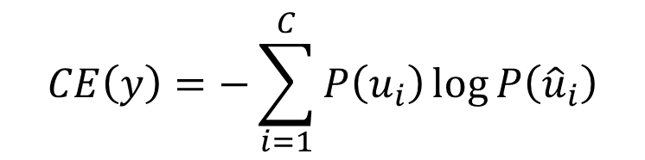
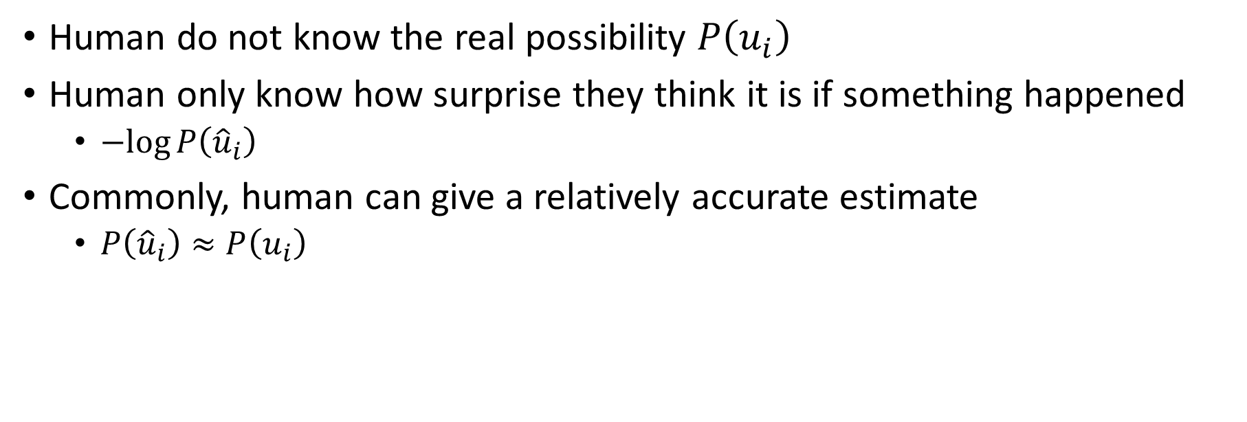
*Cross Entropy
$$CE\left(y\right)=−\sum_{i=1}^{C}{P\left(u_{i}\right)\log{P\left({\hat{u}}_{i}\right)}}$$
Human do not know the real possibility $P\left(u_{i}\right)$
Human only know how surprise they think it is if something happened
$−log{P\left({\hat{u}}_{i}\right)}$
Commonly, human can give a relatively accurate estimate
$P\left({\hat{u}}_{i}\right)≈P\left(u_{i}\right)$

Slide 11
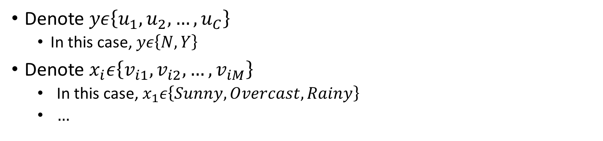
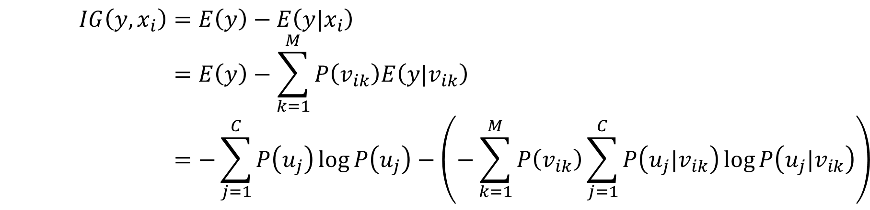
Information Gain
Denote $yε\left\{u_{1},u_{2},…,u_{C}\right\}$
In this case, $yε\left\{N,Y\right\}$
Denote $x_{i}ε\left\{v_{i1},v_{i2},…,v_{iM}\right\}$
In this case, $x_{1}ε\left\{Sunny, Overcast, Rainy\right\}$
$…$
Loss Function
$$IG\left(y,x_{i}\right)=E\left(y\right)−E\left(y|x_{i}\right)=E\left(y\right)−\sum_{k=1}^{M}{P\left(v_{ik}\right)E\left(y|v_{ik}\right)}=−\sum_{j=1}^{C}{P\left(u_{j}\right)\log{P\left(u_{j}\right)}}−\left(−\sum_{k=1}^{M}{P\left(v_{ik}\right)\sum_{j=1}^{C}{P\left(u_{j}|v_{ik}\right)\log{P\left(u_{j}|v_{ik}\right)}}}\right)$$

Slide 12
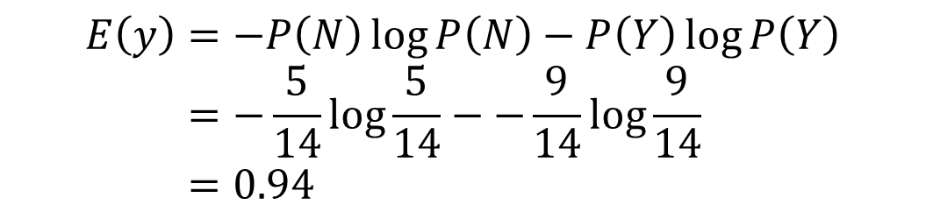
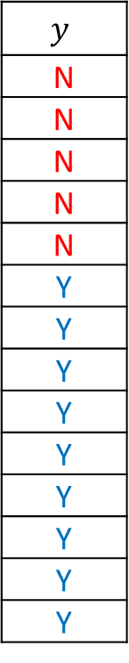
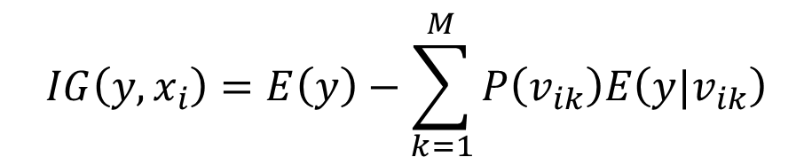
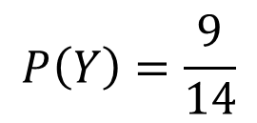
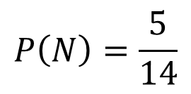
Optimization
$$IG\left(y,x_{i}\right)=E\left(y\right)−\sum_{k=1}^{M}{P\left(v_{ik}\right)E\left(y|v_{ik}\right)}$$
$$y$$
N
N
N
N
N
Y
Y
Y
Y
Y
Y
Y
Y
Y
$$P\left(N\right)=\frac{5}{14}$$
$$P\left(Y\right)=\frac{9}{14}$$
$$E\left(y\right)=−P\left(N\right)\log{P\left(N\right)}−P\left(Y\right)\log{P\left(Y\right)}=−\frac{5}{14}log\frac{5}{14}−−\frac{9}{14}log\frac{9}{14}=0.94$$

Slide 13
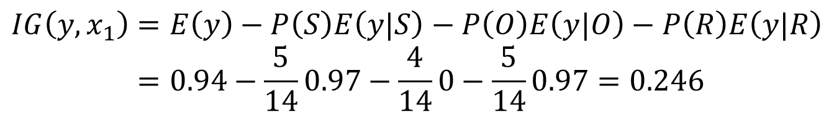
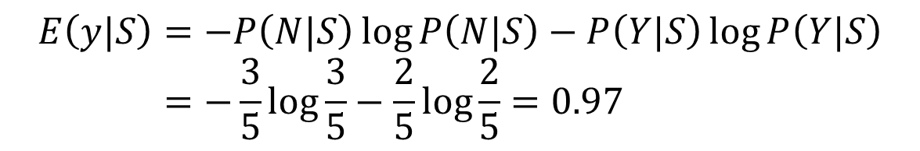
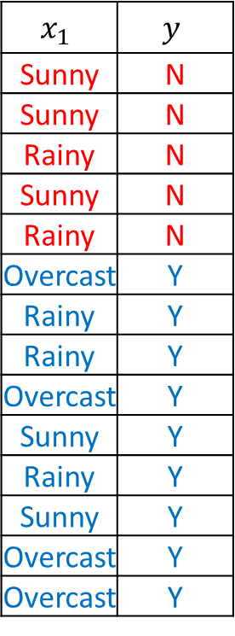
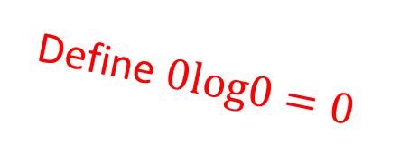
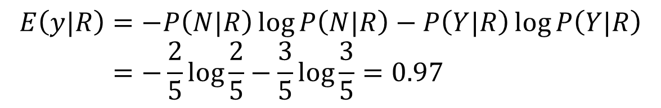
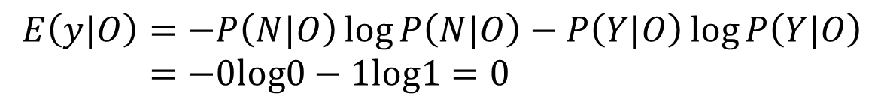
Optimization
$$IG\left(y,x_{i}\right)=E\left(y\right)−\sum_{k=1}^{M}{P\left(v_{ik}\right)E\left(y|v_{ik}\right)}$$
$$x_{1}$$ | $$y$$
Sunny | N
Sunny | N
Rainy | N
Sunny | N
Rainy | N
Overcast | Y
Rainy | Y
Rainy | Y
Overcast | Y
Sunny | Y
Rainy | Y
Sunny | Y
Overcast | Y
Overcast | Y
$$E\left(y|S\right)=−P\left(N|S\right)\log{P\left(N|S\right)}−P\left(Y|S\right)\log{P\left(Y|S\right)}=−\frac{3}{5}log\frac{3}{5}−\frac{2}{5}log\frac{2}{5}=0.97$$
$$E\left(y|O\right)=−P\left(N|O\right)\log{P\left(N|O\right)}−P\left(Y|O\right)\log{P\left(Y|O\right)}=−0log0−1log1=0$$
Define $0log0=0$
$$E\left(y|R\right)=−P\left(N|R\right)\log{P\left(N|R\right)}−P\left(Y|R\right)\log{P\left(Y|R\right)}=−\frac{2}{5}log\frac{2}{5}−\frac{3}{5}log\frac{3}{5}=0.97$$
$$IG\left(y,x_{1}\right)=E\left(y\right)−P\left(S\right)E\left(y|S\right)−P\left(O\right)E\left(y|O\right)−P\left(R\right)E\left(y|R\right)=0.94−\frac{5}{14}0.97−\frac{4}{14}0−\frac{5}{14}0.97=0.246$$

Slide 14

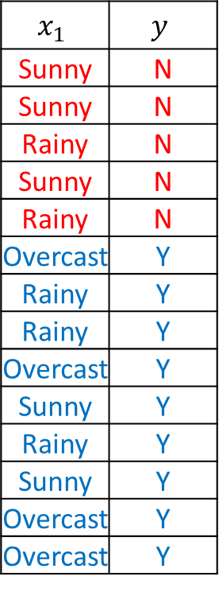


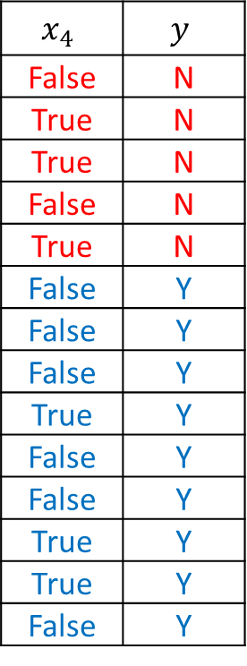
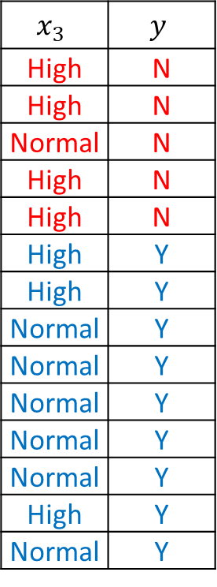
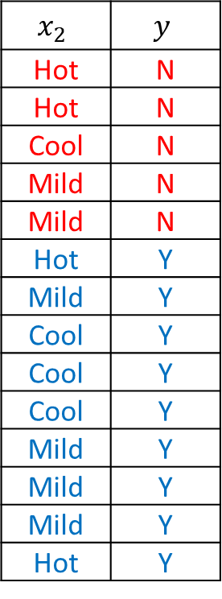

Optimization
$$x_{1}$$ | $$y$$
Sunny | N
Sunny | N
Rainy | N
Sunny | N
Rainy | N
Overcast | Y
Rainy | Y
Rainy | Y
Overcast | Y
Sunny | Y
Rainy | Y
Sunny | Y
Overcast | Y
Overcast | Y
$$x_{2}$$ | $$y$$
Hot | N
Hot | N
Cool | N
Mild | N
Mild | N
Hot | Y
Mild | Y
Cool | Y
Cool | Y
Cool | Y
Mild | Y
Mild | Y
Mild | Y
Hot | Y
$$x_{3}$$ | $$y$$
High | N
High | N
Normal | N
High | N
High | N
High | Y
High | Y
Normal | Y
Normal | Y
Normal | Y
Normal | Y
Normal | Y
High | Y
Normal | Y
$$x_{4}$$ | $$y$$
False | N
True | N
True | N
False | N
True | N
False | Y
False | Y
False | Y
True | Y
False | Y
False | Y
True | Y
True | Y
False | Y
$$IG\left(y,x_{1}\right)=0.246$$
$$IG\left(y,x_{2}\right)=0.03$$
$$IG\left(y,x_{3}\right)=0.15$$
$$IG\left(y,x_{4}\right)=0.048$$

Slide 15
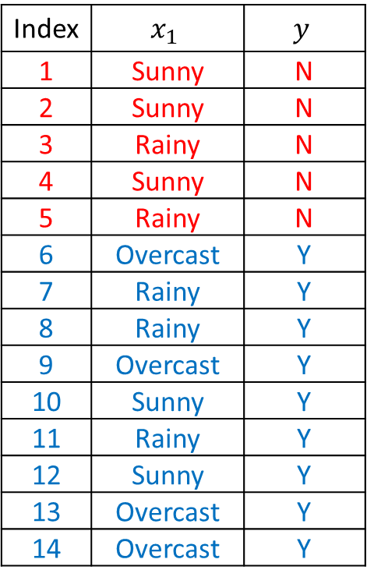
Optimization
1 | N
2 | N
4 | N
10 | Y
12 | Y
We already have the root of the decision tree
Now we can build the branches in the same way
This kind of decision trees is called ID3
Index | $$x_{1}$$ | $$y$$
1 | Sunny | N
2 | Sunny | N
3 | Rainy | N
4 | Sunny | N
5 | Rainy | N
6 | Overcast | Y
7 | Rainy | Y
8 | Rainy | Y
9 | Overcast | Y
10 | Sunny | Y
11 | Rainy | Y
12 | Sunny | Y
13 | Overcast | Y
14 | Overcast | Y
Sunny
6 | Y
9 | Y
13 | Y
14 | Y
Weather
Overcast
Rainy
3 | N
5 | N
7 | Y
8 | Y
11 | Y

Slide 16
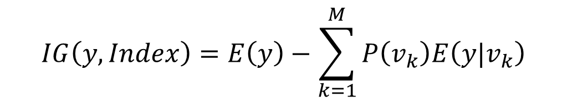
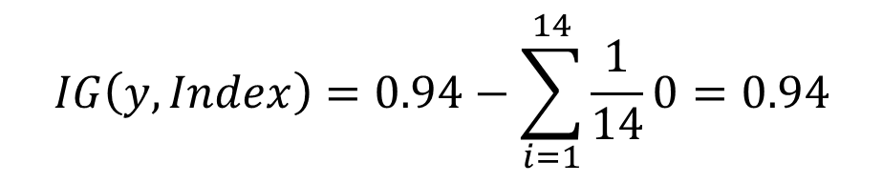
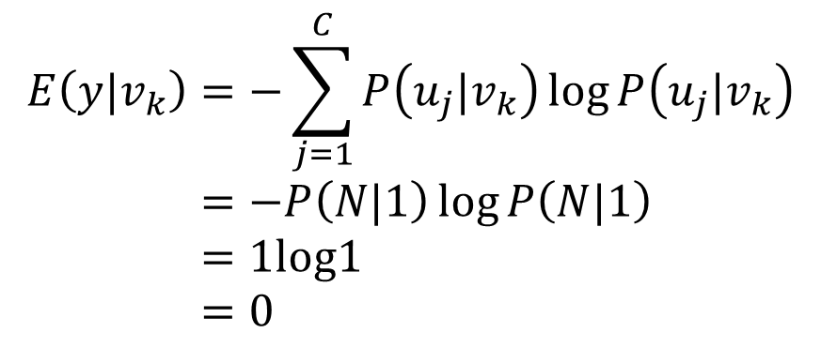
The problem of IG
Index | $$x_{1}$$ | $$y$$
1 | Sunny | N
2 | Sunny | N
3 | Rainy | N
4 | Sunny | N
5 | Rainy | N
6 | Overcast | Y
7 | Rainy | Y
8 | Rainy | Y
9 | Overcast | Y
10 | Sunny | Y
11 | Rainy | Y
12 | Sunny | Y
13 | Overcast | Y
14 | Overcast | Y
$$IG\left(y,Index\right)=E\left(y\right)−\sum_{k=1}^{M}{P\left(v_{k}\right)E\left(y|v_{k}\right)}$$
$$E\left(y|v_{k}\right)=−\sum_{j=1}^{C}{P\left(u_{j}|v_{k}\right)\log{P\left(u_{j}|v_{k}\right)}}=−P\left(N|1\right)\log{P\left(N|1\right)}=1log1=0$$
$$IG\left(y,Index\right)=0.94−\sum_{i=1}^{14}{\frac{1}{14}0}=0.94$$

Slide 17
ID3
Information gain prefers features with a large number of values
ID3 does only considers features with discrete values
ID3 does not support pruning
Thus, C4.5 is proposed
Information gain ratio is introduced
Continuous values are considered
It supports pruning

Slide 18
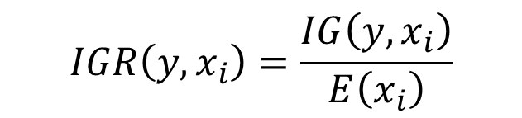

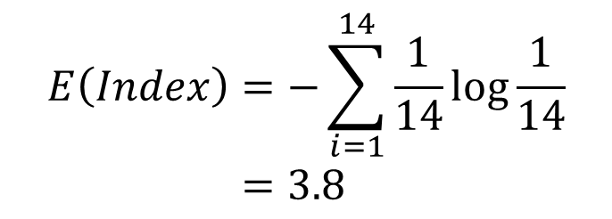
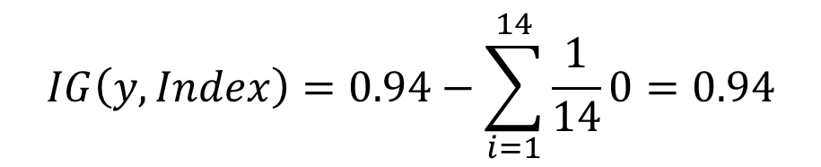
Information Gain Ratio
$$IGR\left(y,x_{i}\right)=\frac{IG\left(y,x_{i}\right)}{E\left(x_{i}\right)}$$
Index | $$x_{1}$$ | $$y$$
1 | Sunny | N
2 | Sunny | N
3 | Rainy | N
4 | Sunny | N
5 | Rainy | N
6 | Overcast | Y
7 | Rainy | Y
8 | Rainy | Y
9 | Overcast | Y
10 | Sunny | Y
11 | Rainy | Y
12 | Sunny | Y
13 | Overcast | Y
14 | Overcast | Y
$$IG\left(y,Index\right)=0.94−\sum_{i=1}^{14}{\frac{1}{14}0}=0.94$$
$$E\left(Index\right)=−\sum_{i=1}^{14}{\frac{1}{14}\log{\frac{1}{14}}}=3.8$$
$$IGR\left(y,Index\right)=0.247$$

Slide 19
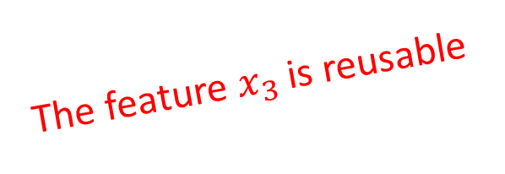
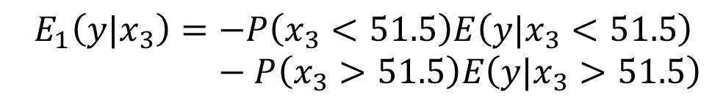
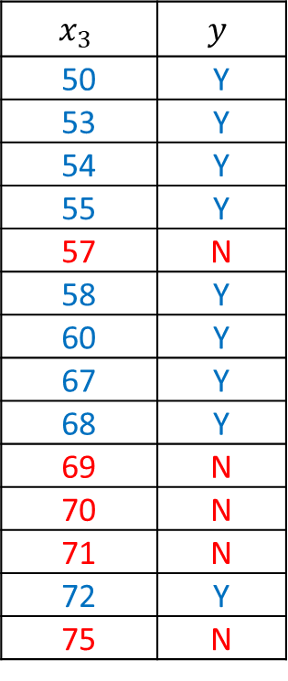
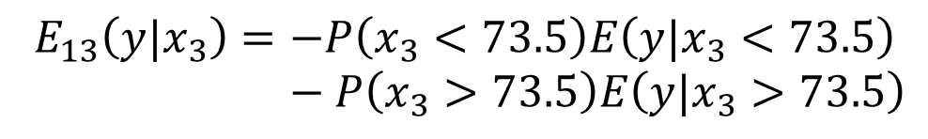
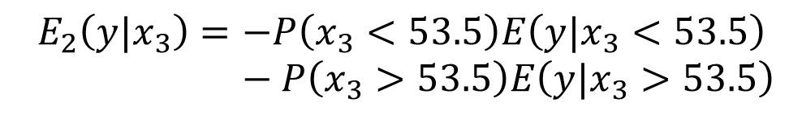
Continuous Value
Try every possible binary split of the samples
Sort the samples first
Humidity | Play Tennis
75 | N
71 | N
57 | N
70 | N
69 | N
67 | Y
72 | Y
50 | Y
58 | Y
60 | Y
54 | Y
53 | Y
68 | Y
55 | Y
$$x_{3}$$ | $$y$$
50 | Y
53 | Y
54 | Y
55 | Y
57 | N
58 | Y
60 | Y
67 | Y
68 | Y
69 | N
70 | N
71 | N
72 | Y
75 | N
$$E_{1}\left(y|x_{3}\right)=−P\left(x_{3}<51.5\right)E\left(y|x_{3}<51.5\right)−P\left(x_{3}>51.5\right)E\left(y|x_{3}>51.5\right)$$
$$E_{2}\left(y|x_{3}\right)=−P\left(x_{3}<53.5\right)E\left(y|x_{3}<53.5\right)−P\left(x_{3}>53.5\right)E\left(y|x_{3}>53.5\right)$$
$$…$$
$$E_{13}\left(y|x_{3}\right)=−P\left(x_{3}<73.5\right)E\left(y|x_{3}<73.5\right)−P\left(x_{3}>73.5\right)E\left(y|x_{3}>73.5\right)$$
$$E\left(y|x_{3}\right)=\min\left(E_{1},E_{2},…,E_{13}\right)$$
The feature $x_{3}$ is reusable

Slide 20
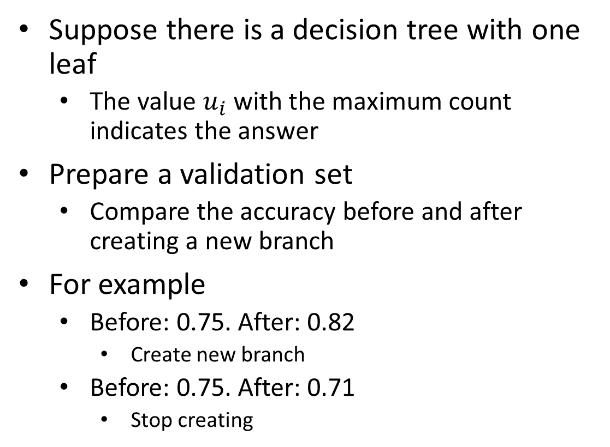

Pre-pruning
Before
After
$$y$$
N
N
N
N
N
Y
Y
Y
Y
Y
Y
Y
Y
Y
1 | N
2 | N
4 | N
10 | Y
12 | Y
Suppose there is a decision tree with one leaf
The value $u_{i}$with the maximum count indicates the answer
Prepare a validation set
Compare the accuracy before and after creating a new branch
For example
Before: 0.75. After: 0.82
Create new branch
Before: 0.75. After: 0.71
Stop creating
Sunny
6 | Y
9 | Y
13 | Y
14 | Y
Weather
Overcast
Rainy
3 | N
5 | N
7 | Y
8 | Y
11 | Y

Slide 21


Post-pruning
1 | N
2 | N
4 | N
N
1 | N
2 | N
4 | N
10 | Y
12 | Y
High
$$…$$
Suppose the decision tree has been finished building
Prepare a validation set
Compare the accuracy before and after delete a branch
For example
Before: 0.75. After: 0.82
Delete the branch
Before: 0.75. After: 0.71
Stop deleting
Humidity
Normal
10 | Y
12 | Y
Y
6 | Y
9 | Y
13 | Y
14 | Y
$$…$$
Y
Before
After
3 | N
5 | N
N
3 | N
5 | N
7 | Y
8 | Y
11 | Y
True
$$…$$
Windy
False
7 | Y
8 | Y
11 | Y
Y

Slide 22
C4.5
C4.5 does not support regression on continuous values
C4.5 builds a multiway tree
It allows many branches in a single layer
C4.5 includes many log function computations
Thus, CART (Classification and Regression Tree) is proposed
Gini index is introduced
It builds a binary tree
It supports regression

Slide 23
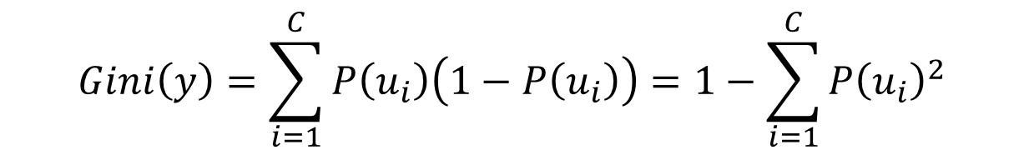



Gini Index
$$Gini\left(y\right)=\sum_{i=1}^{C}{P\left(u_{i}\right)\left(1−P\left(u_{i}\right)\right)}=1−\sum_{i=1}^{C}{{P\left(u_{i}\right)}^{2}}$$
$$y$$
N
N
N
N
N
Y
Y
Y
Y
Y
Y
Y
Y
Y
$$Gini\left(y\right)=1−{P\left(N\right)}^{2}−{P\left(Y\right)}^{2}=1−{\left(\frac{5}{14}\right)}^{2}−{\left(\frac{9}{14}\right)}^{2}=0.459$$
If $P\left(N\right)=0$
$Gini\left(y\right)=1−0−1=0$
If $P\left(Y\right)=0$
$Gini\left(y\right)=1−1−0=0$

Slide 24



CART
CART builds a binary tree
Index | $$x_{1}$$ | $$y$$
1 | Sunny | N
2 | Sunny | N
3 | Rainy | N
4 | Sunny | N
5 | Rainy | N
6 | Overcast | Y
7 | Rainy | Y
8 | Rainy | Y
9 | Overcast | Y
10 | Sunny | Y
11 | Rainy | Y
12 | Sunny | Y
13 | Overcast | Y
14 | Overcast | Y
$$Gini\left(y|x_{i}=v_{ik}\right)=P\left(x_{i}=v_{ik}\right)\left(1−\sum_{i=1}^{C}{{P\left(u_{i}|x_{i}=v_{ik}\right)}^{2}}\right)+P\left(x_{i}≠v_{ik}\right)\left(1−\sum_{i=1}^{C}{{P\left(u_{i}|x_{i}≠v_{ik}\right)}^{2}}\right)$$
$$Gini\left(y|x_{i}=S\right)=P\left(x_{i}=S\right)\left(1−{P\left(N|x_{i}=S\right)}^{2}−{P\left(Y|x_{i}=S\right)}^{2}\right)+P\left(x_{i}≠S\right)\left(1−{P\left(N|x_{i}≠S\right)}^{2}−{P\left(Y|x_{i}≠S\right)}^{2}\right)=\frac{5}{14}\left(1−{\left(\frac{3}{5}\right)}^{2}−{\left(\frac{2}{5}\right)}^{2}\right)+\frac{9}{14}\left(1−{\left(\frac{2}{9}\right)}^{2}−{\left(\frac{7}{9}\right)}^{2}\right)=0.394$$

Slide 25




CART
Index | $$x_{1}$$ | $$y$$
1 | Sunny | N
2 | Sunny | N
3 | Rainy | N
4 | Sunny | N
5 | Rainy | N
6 | Overcast | Y
7 | Rainy | Y
8 | Rainy | Y
9 | Overcast | Y
10 | Sunny | Y
11 | Rainy | Y
12 | Sunny | Y
13 | Overcast | Y
14 | Overcast | Y
$$Gini\left(y|S\right)=0.394$$
$$Gini\left(y|R\right)=\frac{5}{14}\left(1−{\left(\frac{2}{5}\right)}^{2}−{\left(\frac{3}{5}\right)}^{2}\right)+\frac{9}{14}\left(1−{\left(\frac{3}{9}\right)}^{2}−{\left(\frac{6}{9}\right)}^{2}\right)=0.457$$
$$Gini\left(y|O\right)=\frac{4}{14}\left(1−{\left(\frac{0}{4}\right)}^{2}−{\left(\frac{4}{4}\right)}^{2}\right)+\frac{10}{14}\left(1−{\left(\frac{5}{10}\right)}^{2}−{\left(\frac{5}{10}\right)}^{2}\right)=0.357$$
A branch that $x_{1}=Overcast$ and $x_{1}≠Overcast$ is created
Is the feature reusable in CART?

Slide 26
Thank you！

